Slide 1
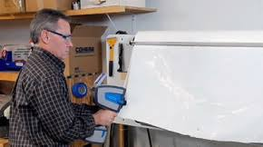
IR spectral analysis of organic compounds via a machine learning approach
IR spectra measurement Illustration using an Agilent 4300 Handheld FTIR
https://www.agilent.com
Ray Gunawidjaja
Mentor: Tony Paek

Slide 2
Presentation outline
Technical background
Motivation
Overview
Machine learning approach
Deep learning approach
Conclusions and recommendations

Slide 3
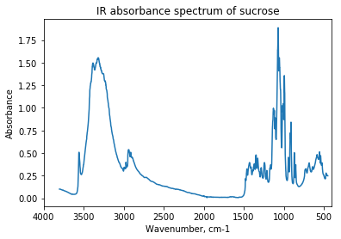
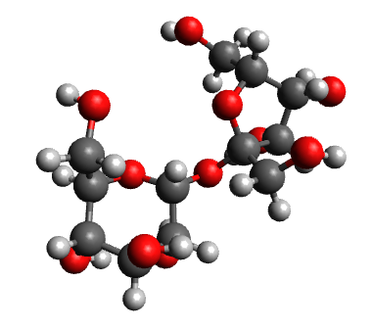
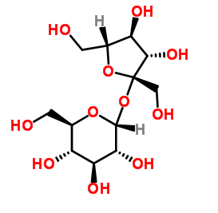
1. Technical Background
Purpose of this work:
Correlate IR spectrum (left) with material’s chemical structure (right)
ML/DL model
Main concept: Peaks in IR spectrum corresponds to certain groups in organic molecules.
| 1. Background | 2. Motivation | 3. Overview | 4. ML&DL approach | 5. Deployment | 6. Conclusions |

Slide 4
2. Motivation/approach
Problem: A manual approach to interpreting IR spectrum tend to be erroneous and time-consuming
Goal: To develop a universal method for unambiguously identifying the chemical compounds of an unknown material from an IR spectrum.
Approach: To utilize modern algorithms.
| 1. Background | 2. Motivation | 3. Overview | 4. ML&DL approach | 5. Deployment | 6. Conclusions |

Slide 5
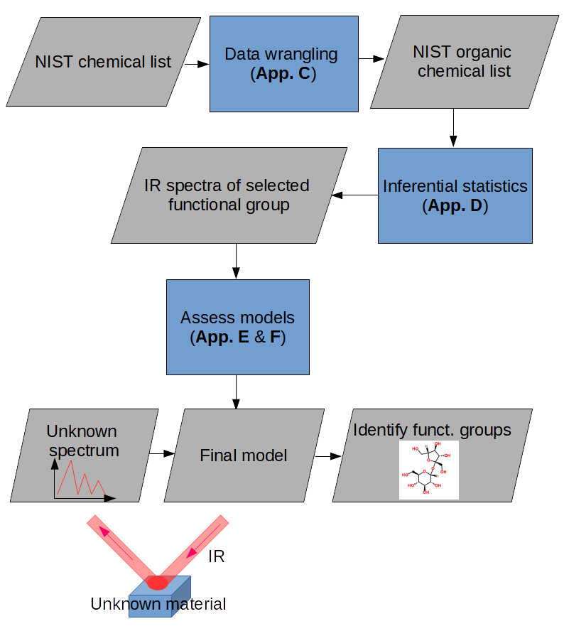
2. Motivation/approach
Overview of approach
| 1. Background | 2. Motivation | 3. Overview | 4. ML&DL approach | 5. Deployment | 6. Conclusions |

Slide 6
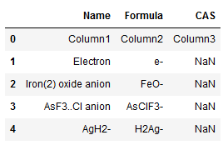
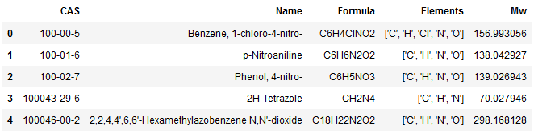
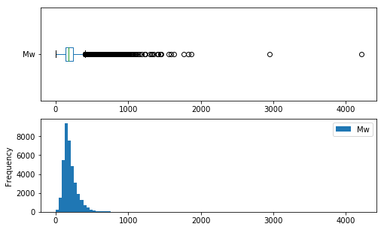
3. Overview of data
http://webbook.nist.gov/chemistry/vib-ser/
A list of: chemical names, chemical formula, and CAS number
Data wrangling: added unique elements and Molecular mass
- Reduced entries from 72,618 to 36,416.
- Removed any entries with NaN and removed non-organic entries.
- Calculated and verified Mw calculation by comparing with published data via web scraping.
- Mw distributions are skewed.
| 1. Background | 2. Motivation | 3. Overview | 4. ML&DL approach | 5. Deployment | 6. Conclusions |

Slide 7

3. Overview of data
- Not all 36,413 compounds have IR spectra.
- For a proof of concept, a total of 613 spectra are downloaded to represent various combination of 10 common functional groups.
- E.g., a sucrose will be labeled as: 1,4,5
- Converting the label to a MultiLabelBinarizer: [1,0,0,1,1,0,0,0,0,0]
C-O
C-O
O-H
C-H
| 1. Background | 2. Motivation | 3. Overview | 4. ML&DL approach | 5. Deployment | 6. Conclusions |

Slide 8
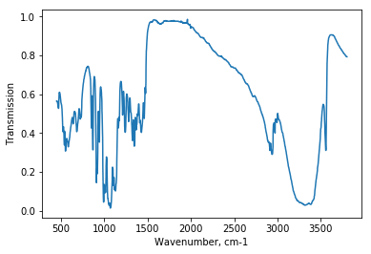
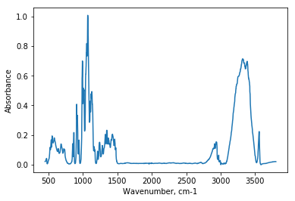
Data preparation
- Using a JCAMP class to read jdx file into a dictionary. File contains x and y values, units, data interval, chemical name, etc.
- Need to do spectra treatment (i.e., unit conversion, background subtraction, and normalization)
-Write reusable functions that are placed in a common.py file for routine spectra treatements.
Spectra treatment
- Correlations are non-linear. Warrants the use of ML and DL

Slide 9
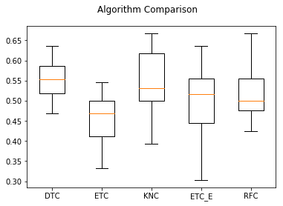
4a. Machine Learning (ML) approach
A survey of ML algorithms
Performed K-fold cross-validation run using:
DTC: DecisionTreeClassifier
ETC: ExtraTreeClassifier
KNC: KNeighborsClassifier
ETC_E: ExtraTreesClassifier (ensemble)
RFC: RandomForestClassifier (ensemble)
DTC shows the highest score with a narrow standard deviation. However, the score of about 55% is much below expectation.
| 1. Background | 2. Motivation | 3. Overview | 4. ML&DL approach | 5. Deployment | 6. Conclusions |

Slide 10
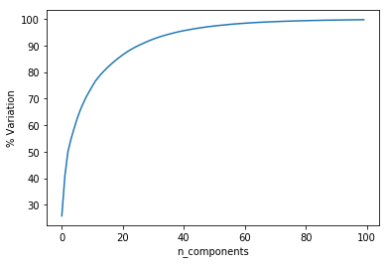
4b. Deep learning approach
Optimized hyperparameters by:
Varying no. of PCA components (20,30,40)
Varying no. of layers and no of neurons
Applying model checkpoint
The best model is given by:
One hidden layer with 512 neurons and 40 components.
| 1. Background | 2. Motivation | 3. Overview | 4. ML&DL approach | 5. Deployment | 6. Conclusions |

Slide 11
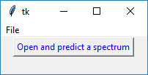
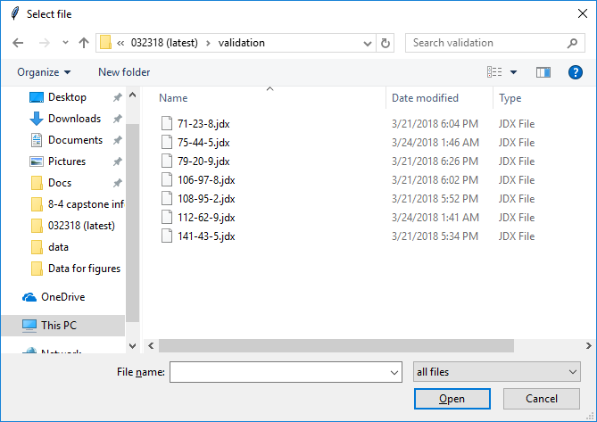
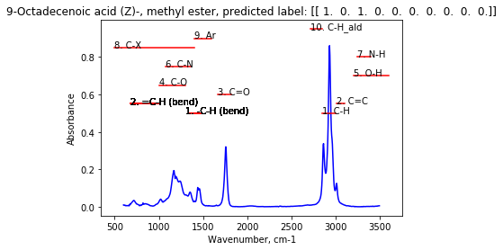
5. Model deployment
Locate an unknown spectrum
Process spectrum and identify peaks using the finalized model
| 1. Background | 2. Motivation | 3. Overview | 4. ML&DL approach | 5. Deployment | 6. Conclusions |

Slide 12
6. Conclusions and recommendations
Conclusions
Using a neural network(NN) model, an average accuracy of about 90% is achieved.
The final NN model consists of one hidden layer and 512 neurons.
A validation dataset yields an accuracy score between 60 and 100%.
The model seems to perform badly in identifying N-H and O-H fragments.
Recommendations for future works
A more accurate model may be obtained by utilizing: a better quality dataset, a larger amount of training dataset, and a more precise labeling scheme.
A more robust model can be generated using a convolutional neural network (CNN). Using CNN, it is possible to use a raw dataset as an input (i.e., the spectral pre-treatment steps that consists of a baseline subtraction and normalization may be skipped.
A different metric may be utilized to monitor the model’s accuracy during optimization runs.
A more elaborate GUI can be designed for a user friendly utilization of the model.
| 1. Background | 2. Motivation | 3. Overview | 4. ML&DL approach | 5. Deployment | 6. Conclusions |

